Slide 1

Explaining Design Framework
William Ng
UX UI Designer

Slide 2
What is a Design System
Visual Design
Usage Guide
Code

Slide 3
Goal (Design System Examples)
https://atlassian.design/components/badge/examples
https://polaris.shopify.com/components/forms/checkbox#navigation
https://www.lightningdesignsystem.com/components/badges/

Slide 4
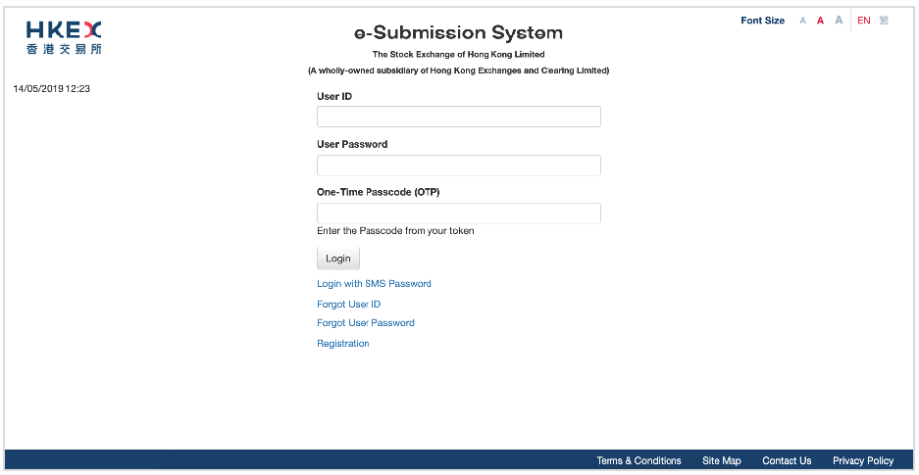
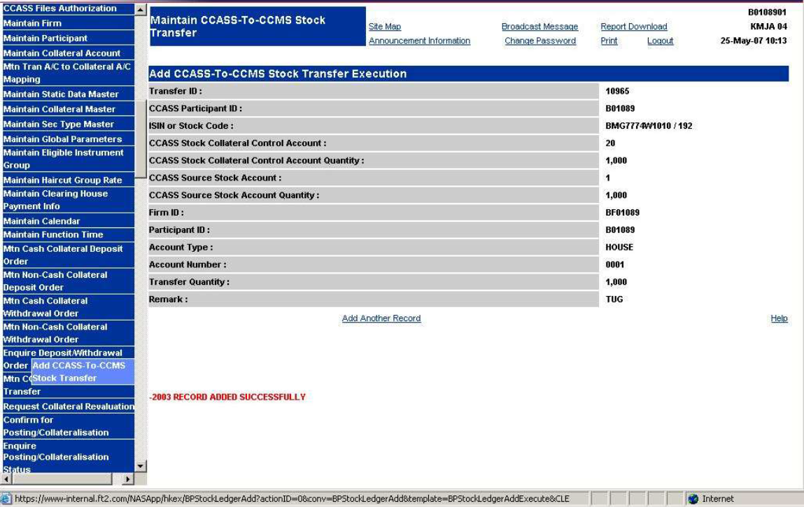
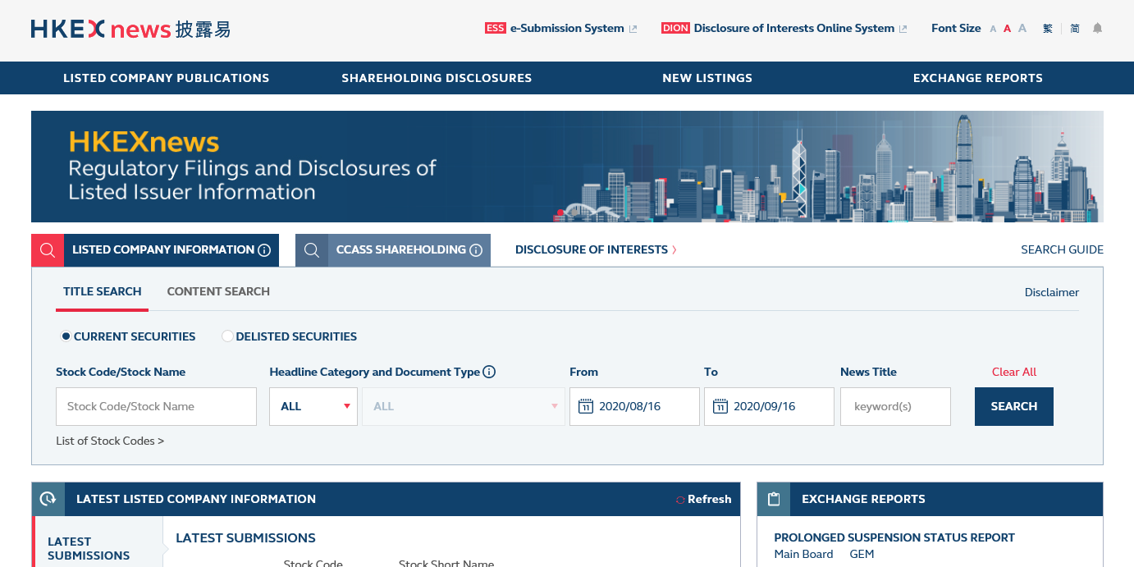
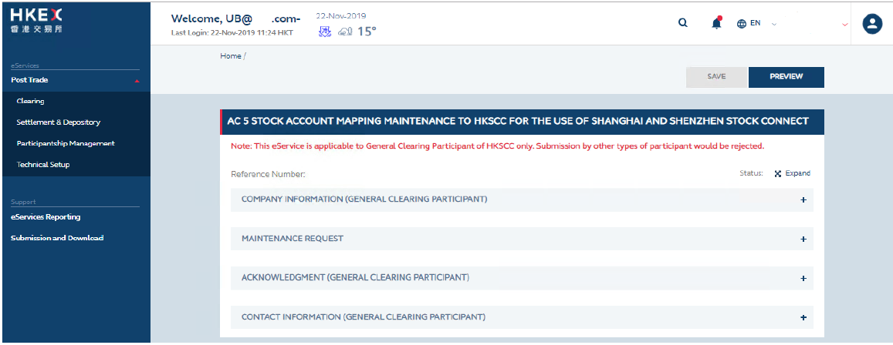
Today
E-Submission System
CCASS
Client Connect
HKEX news
and many more….

Slide 5
Phrase 1
Font Face changed from Roboto to Eillot
Adopted brand’s Primary Color, Secondary Color, Background Color
Footer Bar
Red Search Button
Cards changed to sharp corner
Button changed to sharp conrner
Non-clickable Card remove shadow
Material Theming:
https://material.io/design/material-theming/overview.html

Slide 6
Phrase 1
Design Framework Package:
Axure Library
Design Framework Page
Wireframe Template

Slide 7
Actions
Skill and knowledge sharing.
Appoint future enhancement and maintenance team.

